Slide 1
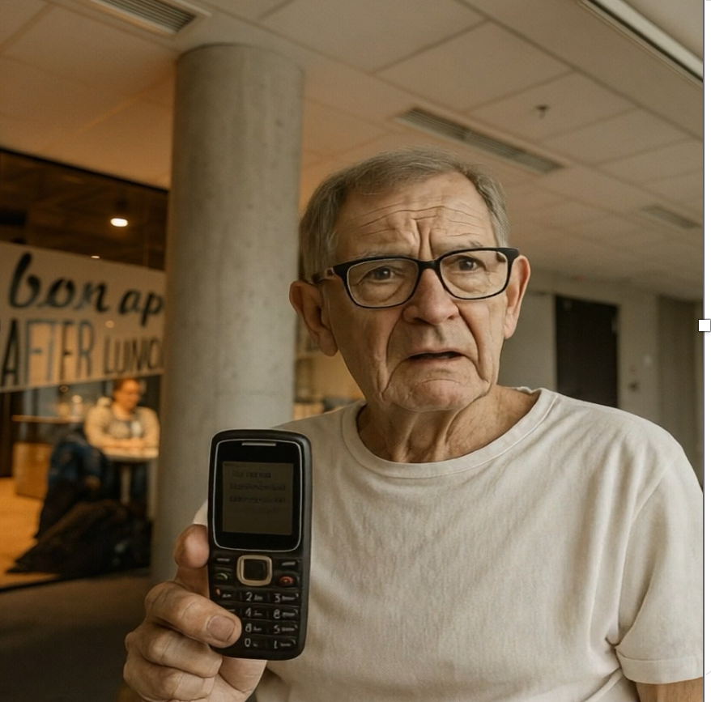
Henry
a 76-year-old retiree

Slide 2



Have you ever struggled with…?
No smartphone
No trust in technology
No internet

Slide 3



Slide 4
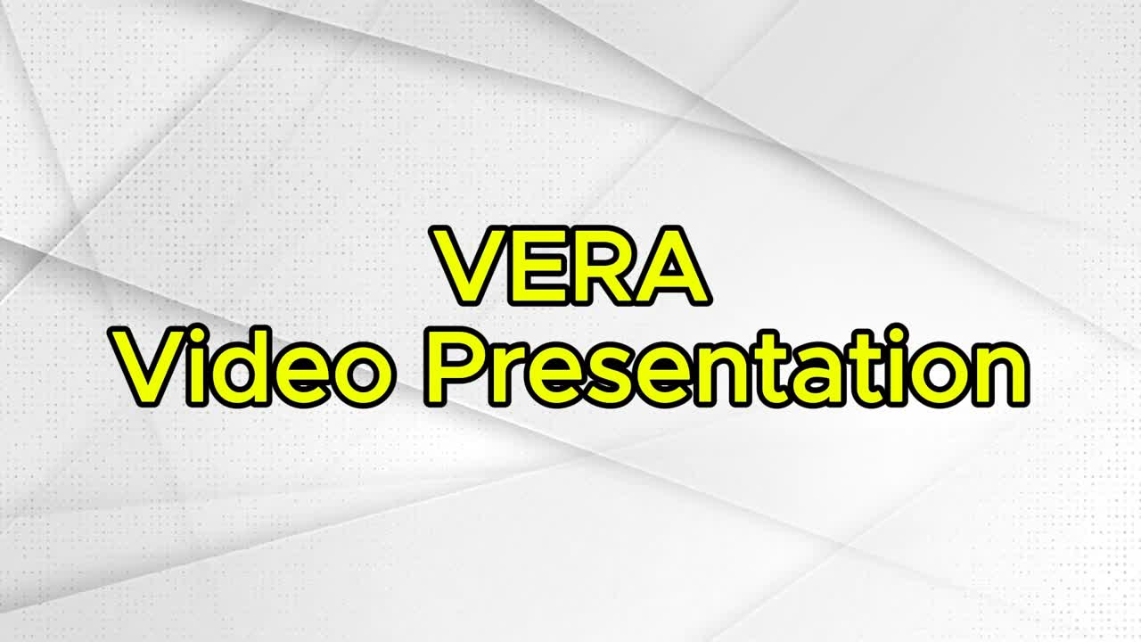

Slide 5





Technology stack
Authentication Module
Twilio
Transaction Intelligence Engine
Groq LLM API

Slide 6
How It Works
Phone call enters system
Twilio receives and routes call
Auth module verifies identity
Groq API provides LLM
Engine process the instructions
SMS notification

Slide 7



The Power of VERA
Zero Digital Barriers
Instant Access
Automated Operations
Cost Optimization
Customer Assurance
Stronger Loyalty

Slide 8


Possible enhancements
1
Intelligent Fraud Detection
Expanded Action Set deposits, investments, and more
2
3
Financial Advisor

Slide 9
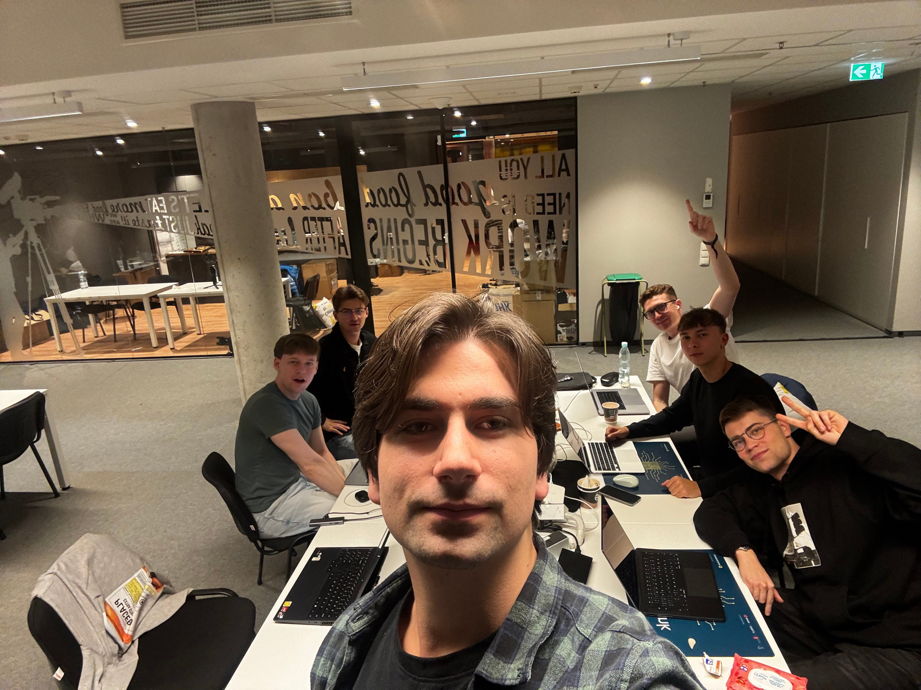

Online banking for everyone, being offline ~ AiHolics

